Slide 1
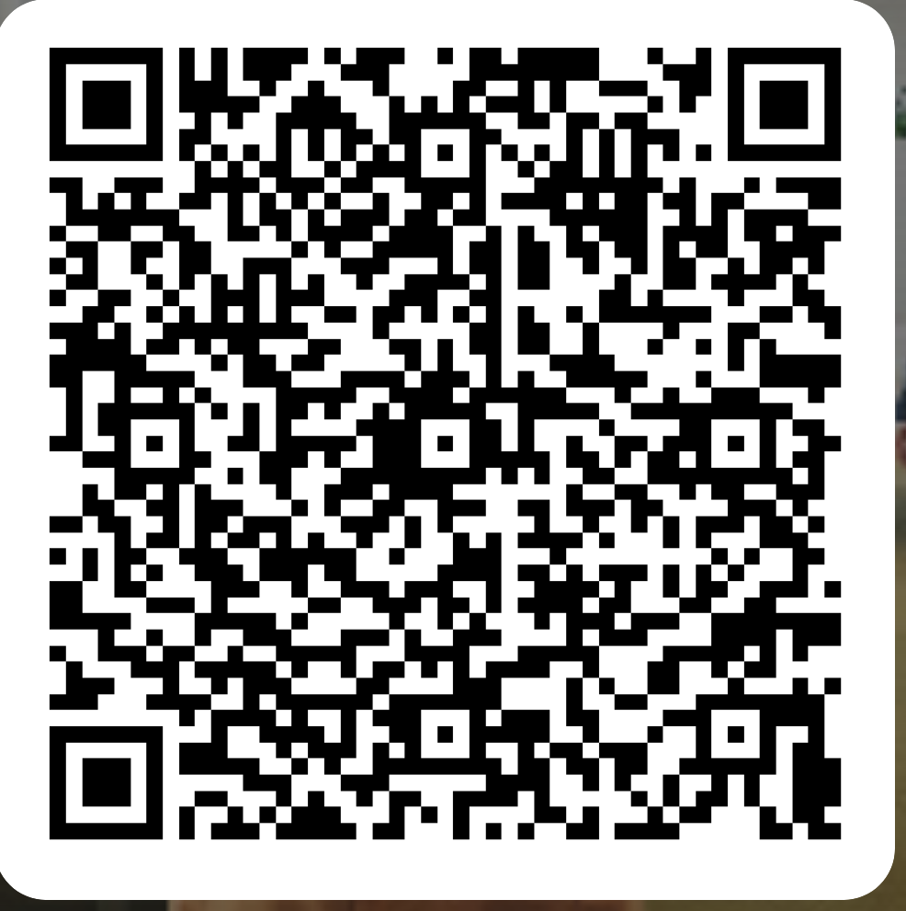
Come join the PC-BAN/DSBA/BITM!
The PC is an important body (required by law) in which students and lecturers at the most local level discuss the quality of education
Advice on curriculum design, quality assurance, and policy-making.
Min. 6 meetings per academic year
50/50 lecturers/students
Honourable membership: You represent your fellow students
Grant from the UvA Profiling Fund
Interested? Scan the QR code and fill in the forms
Deadline:
13th of September

